Slide 1
Indications for orthopedic treatment with artificial crowns. Types of artificial crowns. Principles of preparation of teeth in the treatment of artificial crowns.
Доцент кафедры ортопедической стоматологии, к.м.н. Ганисик А.В.

Slide 2
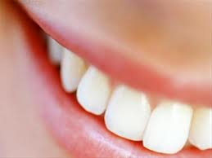
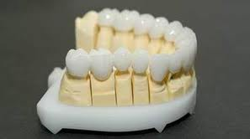
Коронки
Естественные
Искусственные

Slide 3
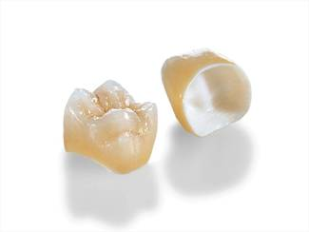
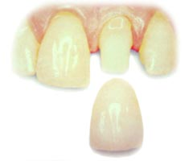
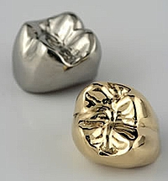
Concept
The crown - an orthopedic construction (restoration), made by laboratory or direct (clinical, if we are talking about temporary crowns), covering the visible part of the tooth.

Slide 4
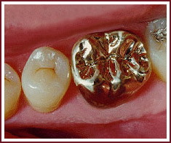
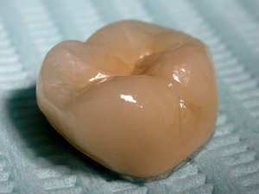
Classification
According to the material
Metallic
noble
gold alloys
silver palladium alloys
ignoble
stainless steel
titanium alloys
cobalt chromium alloys (CXS)
zirconium dioxide
aluminium oxide
Non-metallic
ceramic
plastic
composite
Combined (lined)
metal-ceramic
metal-plastic
metal-composite

Slide 5
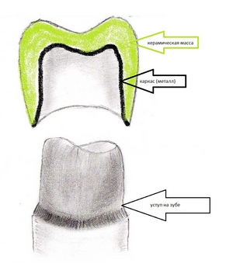
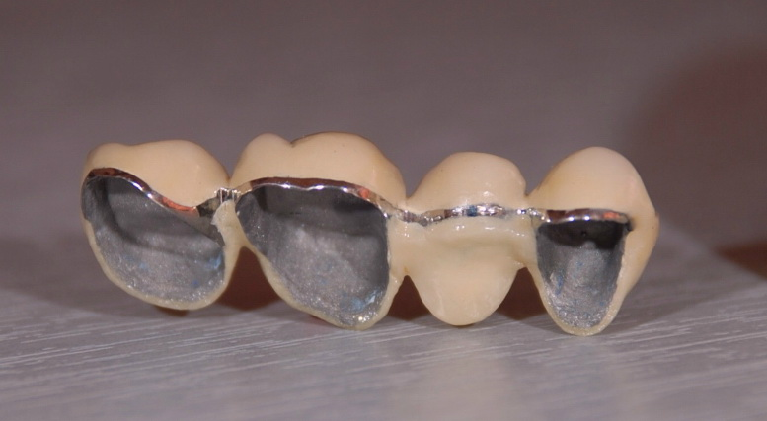
Combined (lined)

Slide 6
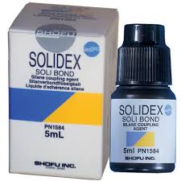
Metal-composite

Slide 7
Metal-plastic

Slide 8
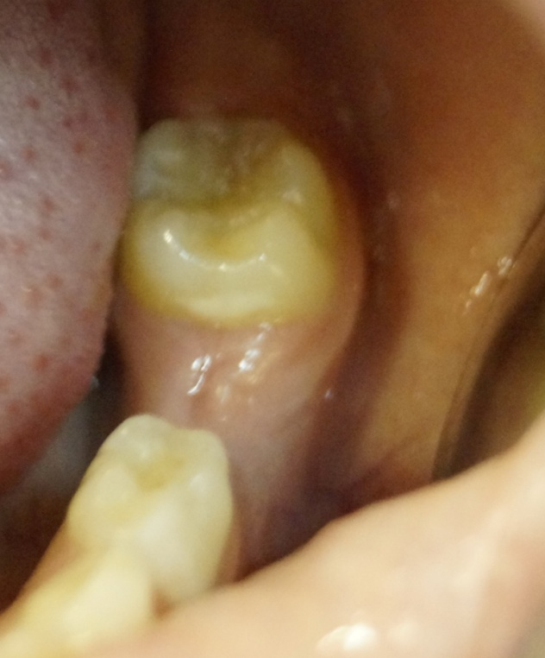
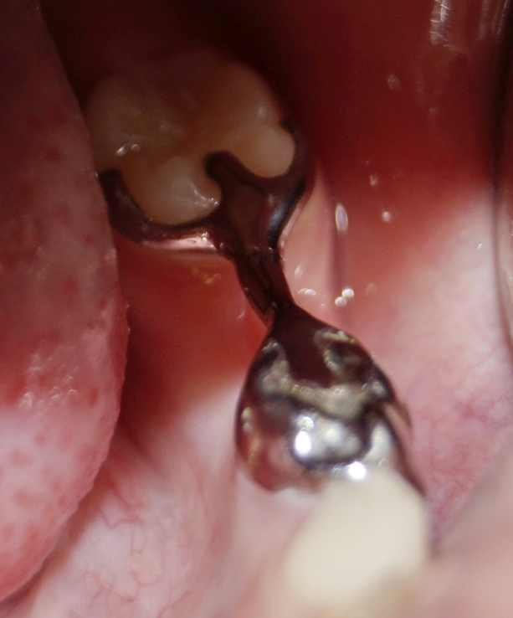
Classification
Classification by purpose
Restoring
Supporting
Fixing
Splinting
Orthodontic

Slide 9
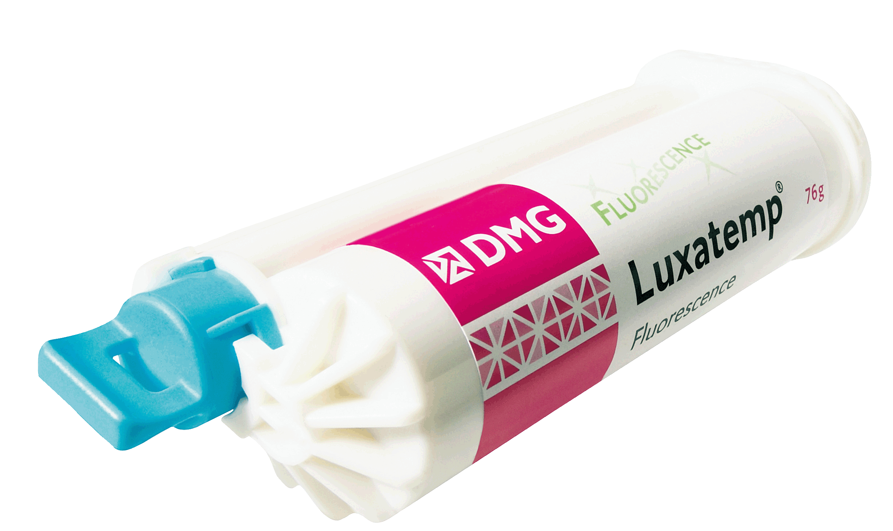
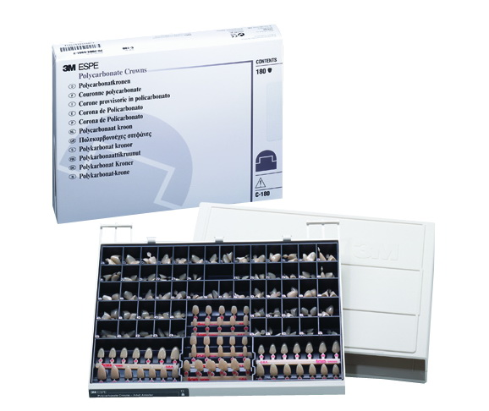
Classification
By time of use
temporary (provisional)
permanent

Slide 10
Temporary crowns
help the patient to get rid of painful sensations in the case of vital vital;
form gingival contour. Warn such an unpleasant complication, as the growth of the gums on the prepared ledge;
protect the prepared tooth from displacement, which can occur as a result of a long time of manufacturing a permanent crown;
and finally, the aesthetic aspect. Help the patient to feel confident, not showing the defects of the teeth to others.

Slide 11
Classification
By design or size and method of coverage of the tooth
Full
partial (3/4)
equatorial (semi-crowns)
armored (veneers)
pin teeth (pin crowns)
Telescopic
fenster crowns

Slide 12
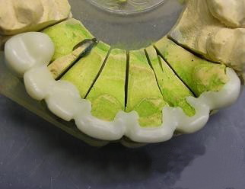
partial (3/4)

Slide 13
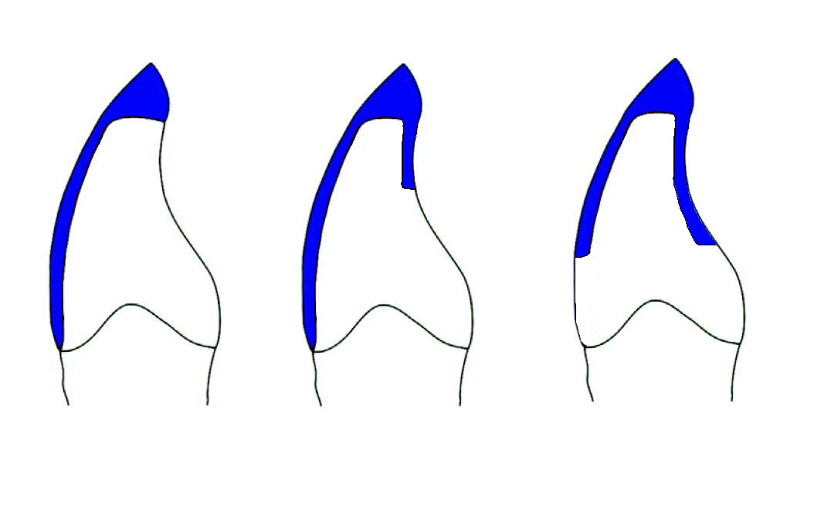
панцирная коронка
¾ коронка
полукоронка

Slide 14
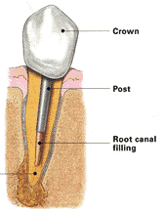
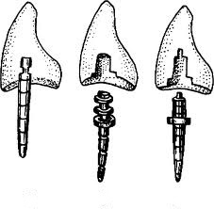
Pin teeth (pin crowns)

Slide 15
Fenster crown

Slide 16
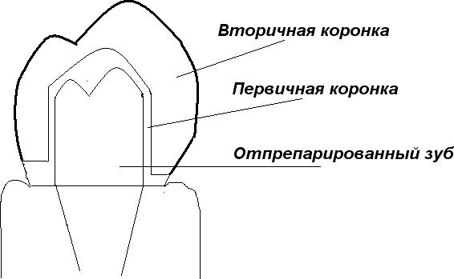
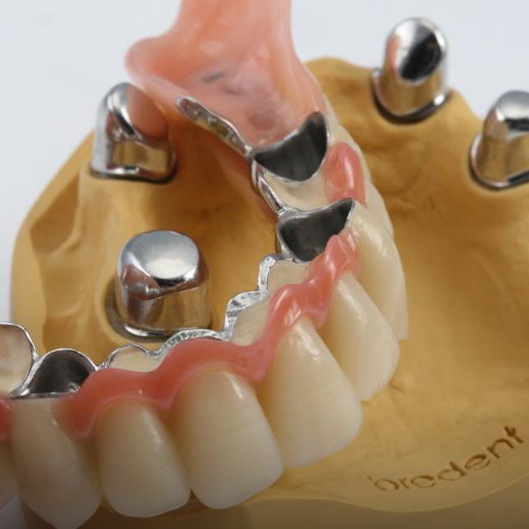
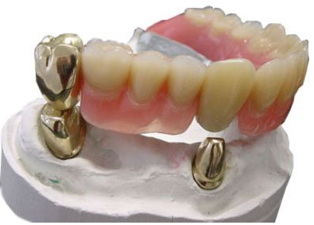
Telescopic crown

Slide 17
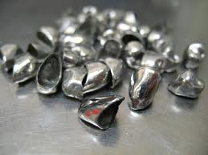
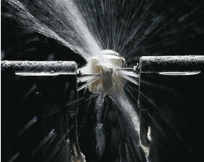
Classification
По методу изготовления
паяные (шовные)
штампованные коронки
литые коронки
полученные методом
полимеризации
полученные методом обжига
фрезерованные коронки
метод лазерного спекания
selective laser melting (SLM)
гальванопластика
3D принтинг (трёхмерный принтинг)

Slide 18
Indications for the manufacture of artificial crowns
TOSFI = 0,6 - 0,8
in case of defects of the tooth crowns due to caries, injuries in which the restoration of the tooth’s shape is not possible with a filling or insertion
with increased abrasion, to restore the anatomical shape of the teeth and the interalveolar distance, prevent further erasure
with anomalies of the shape and position of the tooth in the dental arch, aesthetic defect
non-carious lesions (enamel and dentin hypoplasia, discoloration of teeth)
for fixing bridges (supporting crowns)
for fixing dentures (telescopic crowns)
for fixing a removable denture with clamps, if it is necessary to improve the anatomical shape of the abutment tooth
for fixing various orthodontic and maxillofacial apparatus replacement of poor-quality and old crowns

Slide 19
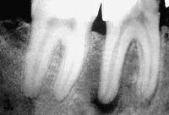
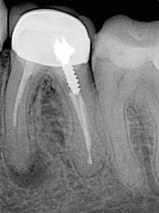
Contraindications for the manufacture of artificial crowns
absolute allergic reaction to the material of the crown
with the mobility of teeth III, IV degree
impossibility of therapeutic or surgical treatment
comparative
low clinical crown
in the presence of teeth with an affected pulp or with poorly sealed root canals (X-ray inspection), with the identification of chronic pathological processes in the periodontium (granulomatous or granulating periodontitis, radicular cyst, etc.)
Age
temporarily contraindicated in patients with severe general condition (IHD, recently suffered a heart attack, acute form of GB)
there are contraindications in the manufacture of certain types of crowns (ceramic, plastic, combined)

Slide 20
Clinical and laboratory stages in the manufacture of stamped crowns
Survey, inspection, diagnosis, treatment planning
Anesthesia setting, odontopreparation, removal of working and auxiliary impressions, registration of central occlusion
Production of gypsum models, wax bases with occlusal rollers
Determination of the central occlusion / jaw ratio, pumping into the occluder / articulator
Making stamped crowns in the laboratory
Fitting crowns in the mouth
Polishing / applying decorative spraying
Cement fixation

Slide 21
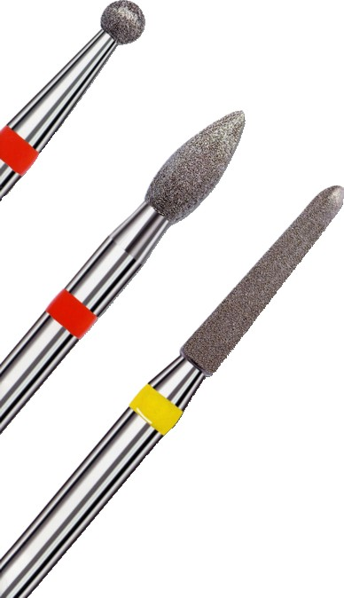
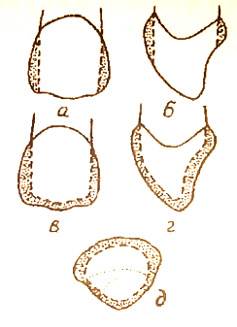
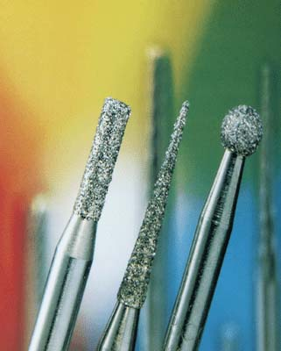
Tooth preparation

Slide 22
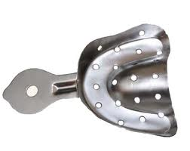
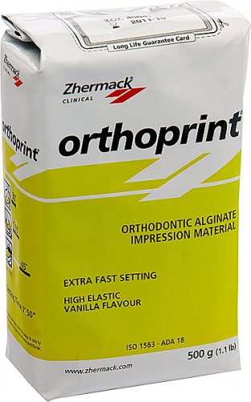
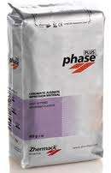
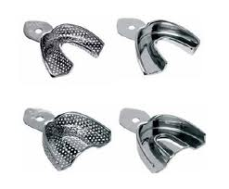
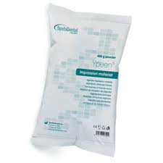
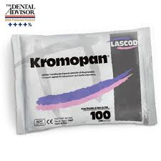
Getting a working and auxiliary impressions

Slide 23
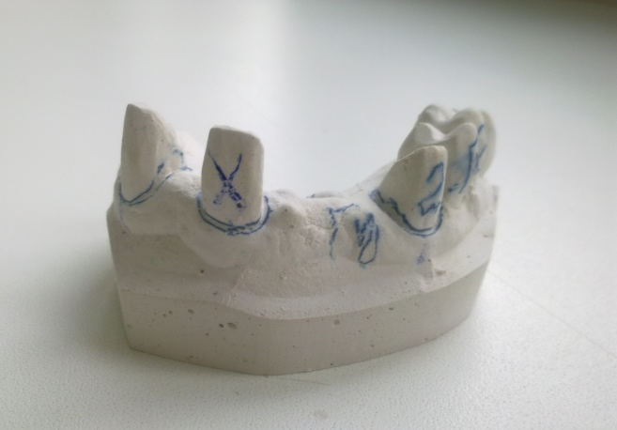
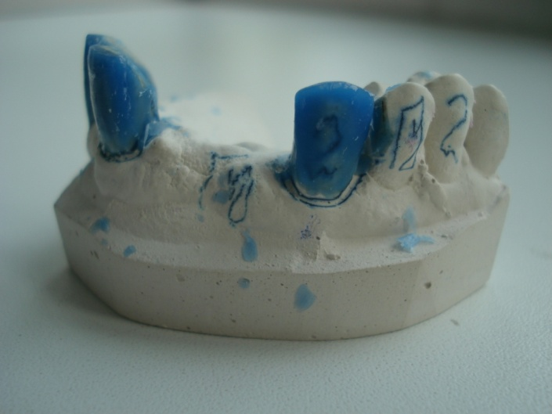
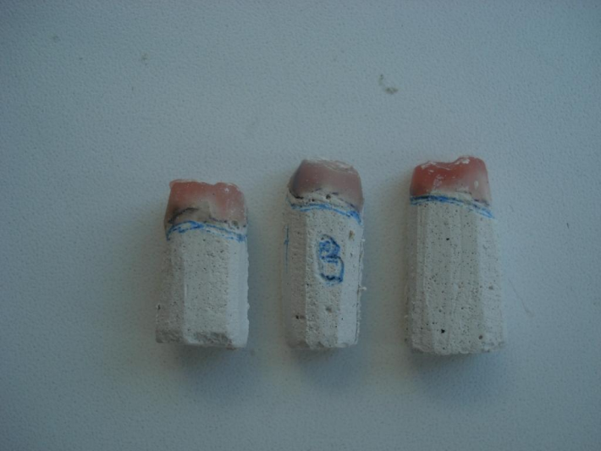
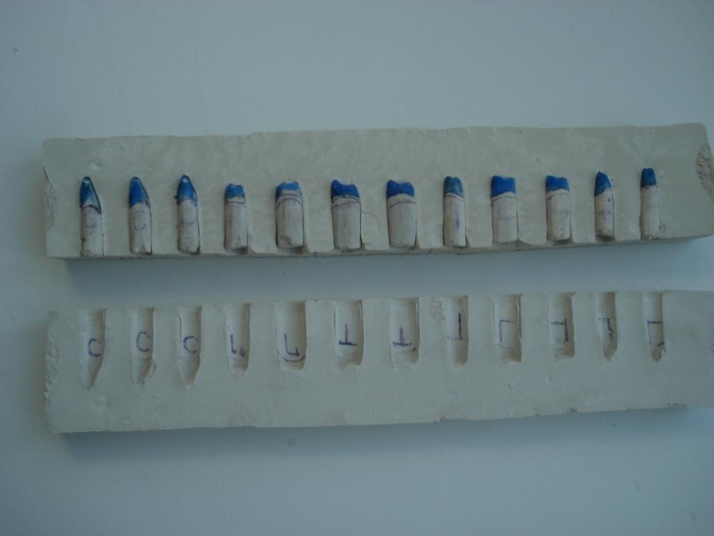
Making plaster models of the jaws, delineating the clinical neck of a tooth, modeling the anatomical shape of the teeth, cutting plaster columns, determining the technical neck of the tooth, gypsum columns in blocks

Slide 24
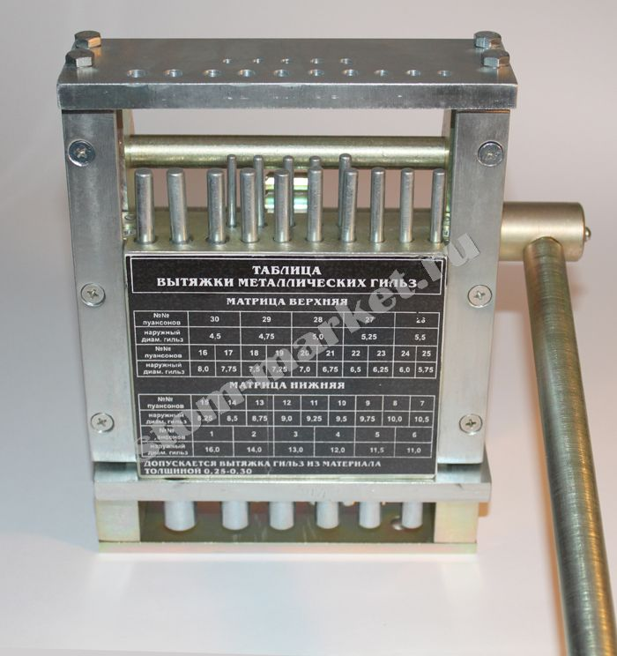
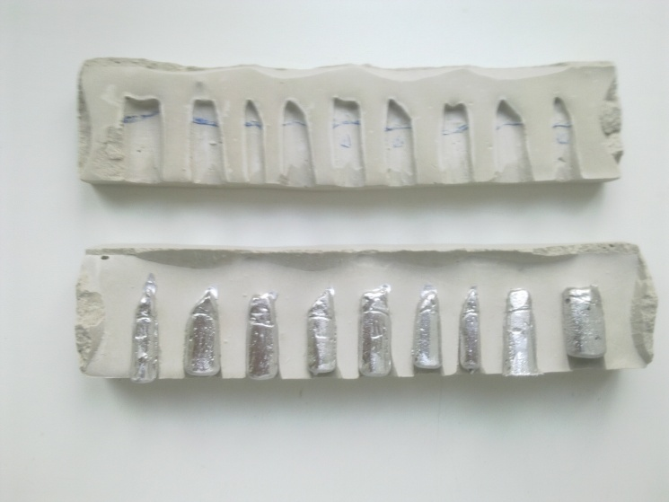
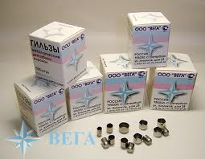
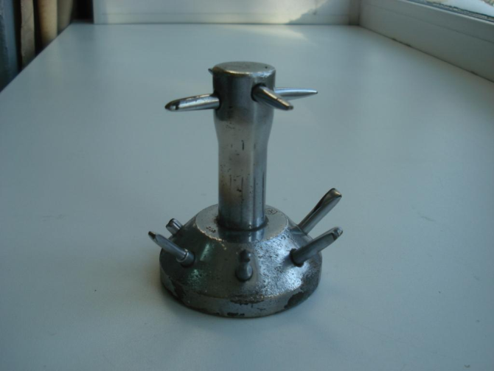
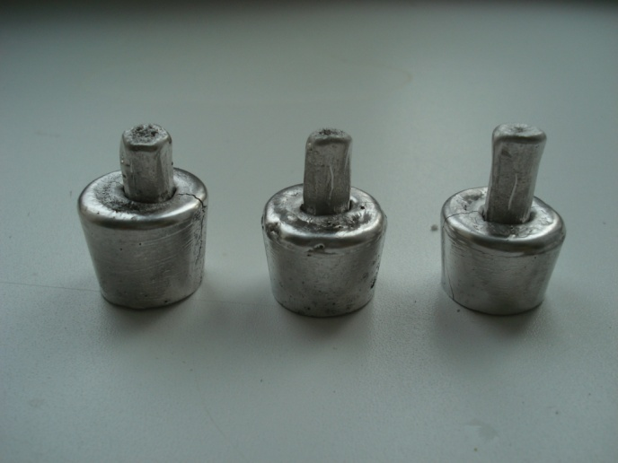
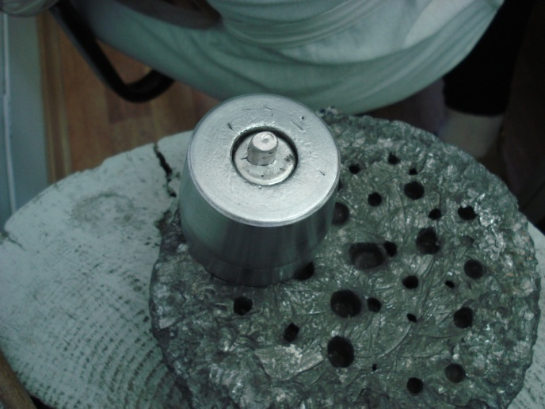
Casting of dies and counterpieces from low-melting metal, selection of a sleeve and its calibration, annealing (1200⁰) and free forging on the anvil, annealing (900⁰), preliminary stamping on a lead cushion, annealing, final stamping (Parker method, Bromshtrom), refinement of the tooth neck, whitening

Slide 25
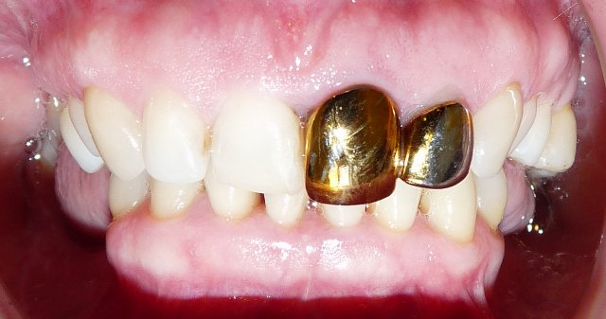
Fitting crowns, polishing, applying decorative spraying, fixing on cement

Slide 26
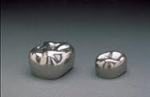
The advantage of stamped crowns
minimum amount of tooth hard tissue preparation
ease of manufacture
low cost of construction

Slide 27
The disadvantages of stamped crowns
stamped crown does not allow to adequately restore the function of a lost tooth (in particular, aesthetic)
it is difficult to achieve an accurate fit of the crown to the tooth in the neck, as a result of which food gets under the edge of the crown, an unpleasant smell and caries can appear
a large layer of cement for fixing the crown that can not provide full tightness for a long time
the use of soldered joints in the manufacture of structures based on stamped crowns often causes galvanism in the oral cavity and electrochemical corrosion of crowns
the metal layer of the stamped structure is rather thin and it eventually wipes through

Slide 28
Clinical and laboratory stages of the manufacture of solid crowns
Survey, inspection, diagnosis, treatment planning
Getting a preliminary impression
Anesthesia setting, odontopreparation, gum retraction, removal of working and auxiliary impressions, bite registration, making, fitting and fixation of temporary crowns
Manufacturing collapsible models
Making wax bases with occlusal rollers
Determination of the central occlusion / jaw ratio, pumping into the occluder / articulator
Modeling wax crowns, casting and processing
Filling in the mouth, grinding and polishing, fixing on the cement

Slide 29
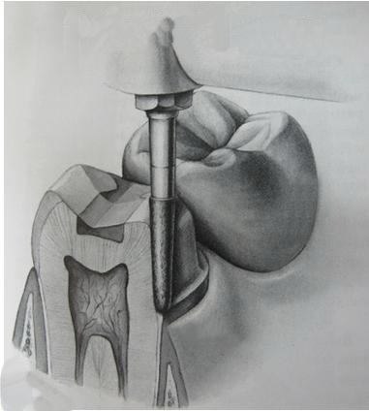
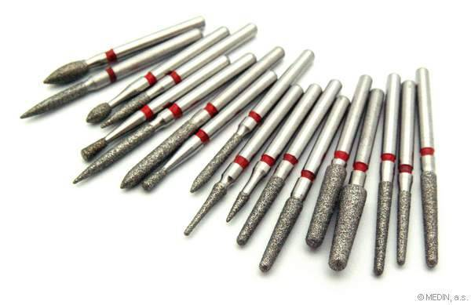
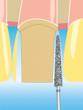
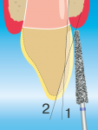
Tooth preparation

Slide 30
Getting a working and auxiliary impressions, registration of central occlusion

Slide 31
Making collapsible models, modeling wax crowns, casting

Slide 32
Fitting in the mouth, polishing, fixing on cement

Slide 33
Advantages of solid crowns
quality, long service life of the structure
durability and wear resistance
insignificant amount of tooth hard tissue preparation
low cost compared to other types of crowns have a natural anatomical shape

Slide 34
The disadvantages of solid crowns
unattractive appearance
use mainly for chewing teeth

Slide 35
Штампованная коронка | Цельнолитая коронка
Объём снимаемых твердых тканей ≈ 0,3 мм | Объём снимаемых твердых тканей ≈ 0,5 мм
Одонтопрепарирование без уступа | Одонтопрепарирование с уступом
Нет необходимости в проведении ретракции десны | Ретракция десны обязательна
Оттиск получают с помощью альгинатной массы (одноэтапный однофазный) | Оттиск получают с помощью силиконовой массы (одноэтапный двухфазный, двухэтапный двухфазный)
Рабочая модель не разборная, изготавливается из гипса (2 класс) | Рабочая модель разборная, изготавливается из гипса (2 класс) и супергипса (3, 4 класс)
Коронка изготавливается методом штампования | Коронка изготавливается методом литья

Slide 36
Благодарю за внимание!

