Slide 1
Fundamentals Of Occlusion

Slide 2
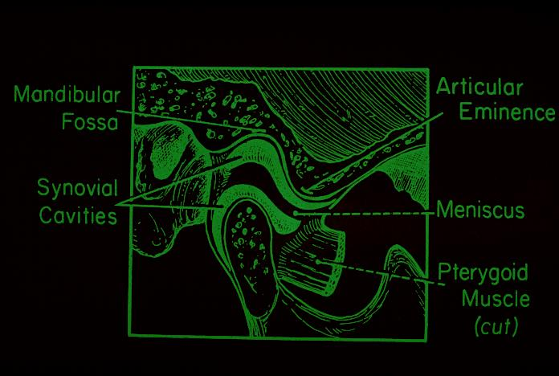
The Temporo-Mandibular Joints

Slide 3
Why Is Occlusion Important ?
Assist in diagnosis
Planning in restorative care
To minimize failure
Ensure predictable outcome by minimising loads on teeth
Managing the environment so that we get the minimal amount
of surprises (Similar to wearing a car seatbelt), the less the
patient has to adapt the better.

Slide 4
Definitions
OCCLUSION
A relationship between the masticatory surfaces of the
maxillary and mandibular teeth
The relationship between tooth contacts and mandibular
movements

Slide 5
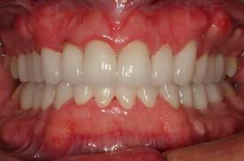
Centric Occlusion
Relationship of the mandible to the maxilla when the teeth are in maximum occlusal contact, irrespective of the position or alignment of the condyle-disk assemblies.
The relationship between the maxilla and mandible
when the teeth are maximally meshed with the
mandible in its most cranial position

Slide 6
Centric Relation
A relationship of the mandible to the skull where the condyle is in an anteriorly, superiorly braced position along the articular eminence of the glenoid fossa, with the articular disc interposed between the Condyle and eminence.

Slide 7
Ideal vs Pathologic Occlusion

Slide 8
Ideal Occlusion
An ideal occlusion should provide comfort and function in
a predictable way.
1) Ideal occlusion at tooth level
Cusp tip to fossa or cusp to marginal ridge contact – i.e no incline contacts
2) Ideal occlusion at articulatory system level
Posterior stability, Anterior guidance, Lack of posterior interferences.
3) Ideal occlusion at patient level
Within the adaptability of the rest of the articulatory system.

Slide 9
Features Of Ideal Occlusion
Anterior Guidance:
In lateral excursions of the mandible, working-side contacts (preferably on the canines) disocclude or separate the nonworking teeth instantly.
In protrusive excursions, anterior tooth contacts will disocclude the posterior teeth.

Slide 10
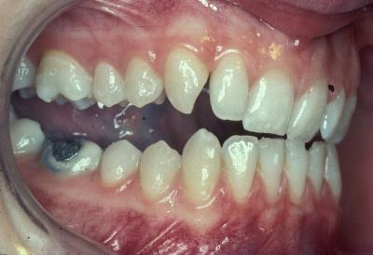
Protrusive Guidance
Excursive Guidance

Slide 11
Features Of Ideal Occlusion
B) Posterior stability:
Enough posterior teeth in each arch with solid and stable
contacts in appropriate positions to evenly distribute loads and
to allow the mandible to close in a reproducible CO. Posterior
teeth contact more heavily than anterior teeth
It is enhanced by tall cusp – deep fossa
Maintains teeth position
CO or ICP is easily reproduced
Increased masticatory function
Signs of lack of PS, drifting, fremitus, fractured rest, mobility & wear

Slide 12
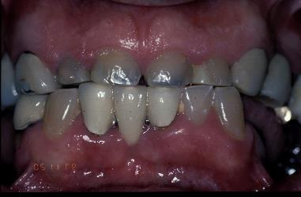
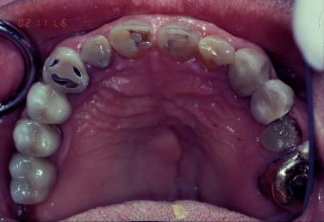
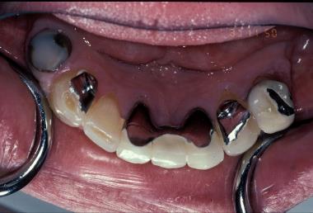
Lack Of Posterior Stability

Slide 13
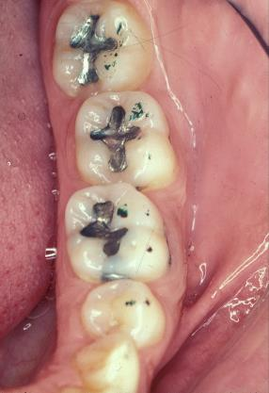
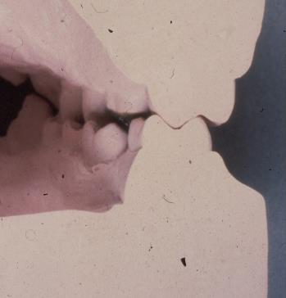
Features Of Ideal Occlusion
C) Absence of posterior interferences
The non-working side

Slide 14
Features Of Ideal Occlusion
D) Centric Occlusion is achieved at centric
relation position
E) Occlusal loads are axially transmitted through
the teeth

Slide 15
Organization Of Occlusion
There are three recognized concepts that describe how teeth should contact in various mandibular positions
Bilateral balanced occlusion
Unilateral Balanced occlusion
(Group function)
3. Mutually protected occlusion
(Canine protected)

Slide 16
Bilateral Balanced Occlusion
It dictates that a maximum number of teeth should contact in all excursive positions of the mandible.
Use for complete denture occlusal scheme as contacts on non-working side prevent tipping of the denture
Not used for fixed prosthodontics, as very difficult to achieve

Slide 17
Unilateral Balanced Occlusion
Also called group function
It requires teeth on the working side to be in contact in lateral excursion and teeth on the non-working side are free of any contact.
Avoids destructive , oblique forces on the non-working side.
Prevents wear of maxillary palatal and mandibular buccal cusps

Slide 18
Mutually Protected Occlusion
Also called canine protected occlusion
Anterior teeth overlap prevents the posterior teeth from making any contact on either the working or the nonworking sides during mandibular excursions.
Anterior teeth bear all the load and the posterior teeth are dis-occluded during excursions. Protecting the posterior teeth
In CO, posterior teeth direct forces through their long axis and anterior teeth are slightly in or out of contact. Protecting the anterior teeth.

Slide 19
Guidance
Describes the influenced path the mandible
takes as a result of the contacting surfaces
of the teeth. Depending on the contact and
shape of the teeth they should be in
harmony

Slide 20
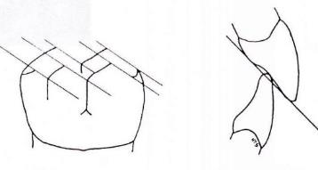
Protrusive Guidance
Influenced path the mandible takes as a
result of a forward thrust

Slide 21
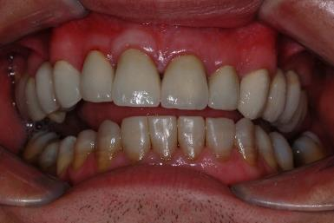
Lateral Guidance
Canine
Describes the way in which lateral excursions are affected by tooth to tooth contacts involving the canine teeth only resulting in disclusion of the posterior teeth

Slide 22
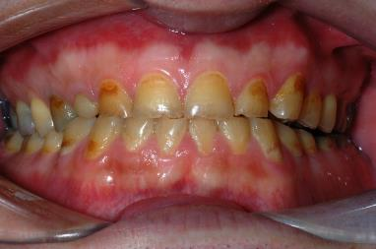
Lateral Guidance
Group function
When lateral excursions are guided by more than one tooth other than the canines

Slide 23
Anterior Guidance
Guidance produced by the teeth themselves and not the
temporomandibular joint (can be on any tooth)
The influence of contacting surfaces of anterior teeth on mandibular movements.
The influence of contacting surfaces of the guide pin and anterior guide table on articulator movements.
The fabrication of a relationship of the anterior teeth preventing the posterior tooth contact in all eccentric mandibular movements.

Slide 24
Jaw Movements

Slide 29
Posselt’s Figure

Slide 30
Posselt’s Figure
MP
ICP
RCP
HA
MP = Maximal protrusion
ICP = Intercuspal position
RCP= Retruded Contact position
HA = Hinge axis
MO = Maximum opening
MO

Slide 31
Posselt’s Figure – top edge
MP
ICP
IG
RCP
EE

Slide 32
Articulators

Slide 33
Definitions
Articulators
A mechanical representation of the jaws and temporo-mandibular joints

Slide 34
Use of articulators
Diagnosis
slides and occlusal relationships
Treatment planning
Diagnostic wax - up
Occlusal adjustment
Fabrication of Splint / Prostheses

Slide 35
Articulators
Types
Simple Hinge
Average Value
Semi-adjustable
Fully adjustable

Slide 36
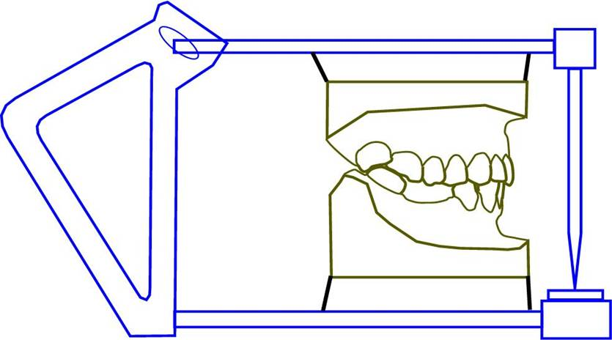
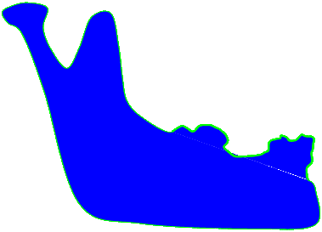
Articulators

Slide 37
Cast Holder

Slide 38
Cast Holder

Slide 39
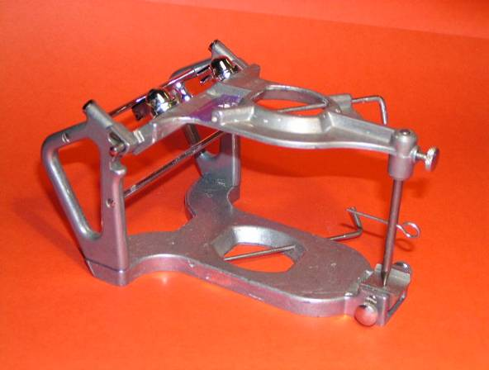
Average Value

Slide 40
Articulators
BONWILL 1854
4”
4”

Slide 41
Articulators
Average Value
4”
4”

Slide 42
Articulators
Average Value

Slide 43
Articulators

Slide 44
Denar II - Arcon

Slide 45
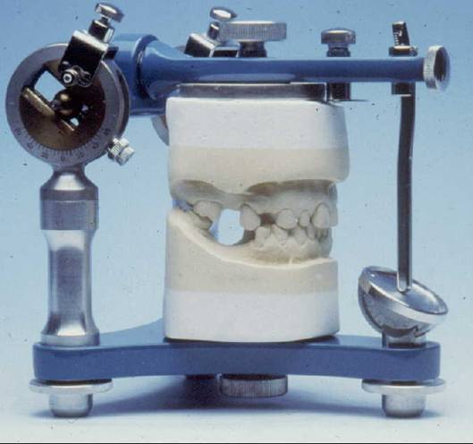
Dentatus
Non Arcon

Slide 46
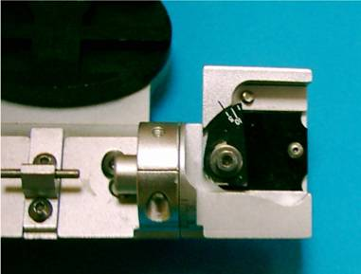
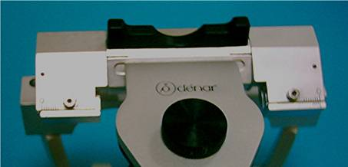
Denar II
Adjustable Condylar Angle, ISS & PSS

Slide 47
Articulators
Semi-adjustable
Can alter;
TMJ to Incisor distance
Bennett Angle
Condylor Guidance Angle
Incisal guidance plate

Slide 48
Articulators
Needs Facebow recording
Ideally should be used for complete denture cases

Slide 49
Facebow recording
For semi adjustable articulator

Slide 50
Facebow

Slide 53
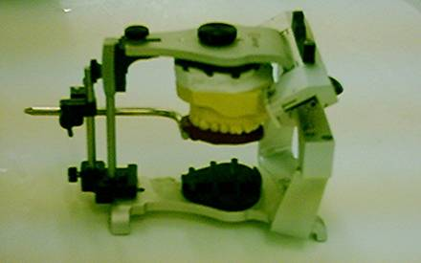

Slide 54
Summary
The choice of articulator depends upon such factors as;
Intended use - Skill of the technician
Availability of equipment - Expense
Patient's occlusion - Skill of the operator
The more closely the articulator matches the patients anatomy, usually the better the outcome and the less adjustment is required at chairside on fitting prostheses.

Slide 55
Key note messages
No articulator is best and no one can record all jaw movements
Articulator can try to record only jaw movements not reproduced anatomy of joint.

Slide 56
THANK YOU

